Slide 1

WHY TO CHOOSE TECHNICAL COURSES AFTER 10TH OR 12TH
Powered by Buddha Institute of Technology

Slide 2
KNOWLEDGE VERSUS SKILL
Knowledge is the theoretical understanding of a subject.
Skills are the proficiencies developed through training or real life experience. We can develop our skills through the transfer of knowledge.
Only knowledge doesn’t help, to build a career one needs knowledge and skill. Any professional study programs helps build your skills. Also a personality development program prepares you for corporate world.

Slide 3
OPTIONS AFTER MATRIC AND INTERMEDIATE
AFTER MATRIC
  Diploma in Engineering
  Industrial Training Institute
  Intermediate in Science or Commerce or Arts
  Indian Army as Technicians
  Indian Navy as Apprentices
  CRPF as Constable
  SSC as Clerks etc.
AFTER INTERMEDIATE
  Engineering
  Medical
  Bachelors of Law
  Chartered Accountant
  Fashion Design
  Business Administration
  Web/Graphics Design
  Hospitality & Food Craft
  Bachelor in general subjects
  Journalism etc.

Slide 4


WHY TO CHOOSE POLYTECHNIC OR ENGINEERING
Non-Smartphone
Generally used for calling only
Now used generally by low literate people
Smartphone
Used for various purposes
  Bill payments
  Chatting
  Recharge
  Ticket booking etc
Used by graduates, businessman or other vendors or professionals
But polytechnic or engineering students can make real use of smartphone and solve small issues of phones if exist. For example, they can operate any instrument from phone such home appliances can be controlled from phone anywhere in world. This cannot be done by general public. Whatever appliance you use or see these days are manufactured by engineering. Digital India would have been distant dream if it wasn’t for engineers.

Slide 5
CAREER PROSPECTS AFTER POLYTECHNIC & ENGINEERING
There are various career prospects after Polytechnic & Engineering:
  GAIL
  DOORDARSHAN
  BARC
  LED INDUSTRY
  SOLAR ENERGY PLANT SETUP
  ENVIRONMENTAL MONITORING DIVISIONS
  AUTOMOTIVE INDUSTRY
  CONSTRUCTION
  TEACHING
  OTHERS
  RAILWAY
  SSC
  BANK CLERKS & PO
  CSIR – 42 Labs.
  ISRO
  DRDO
  NTPC
  BSNL \ MTNL
  BEL
  BHEL
  ONGC
  SAIL

Slide 6

JOBS IN PRIVATE SECTOR

Slide 7

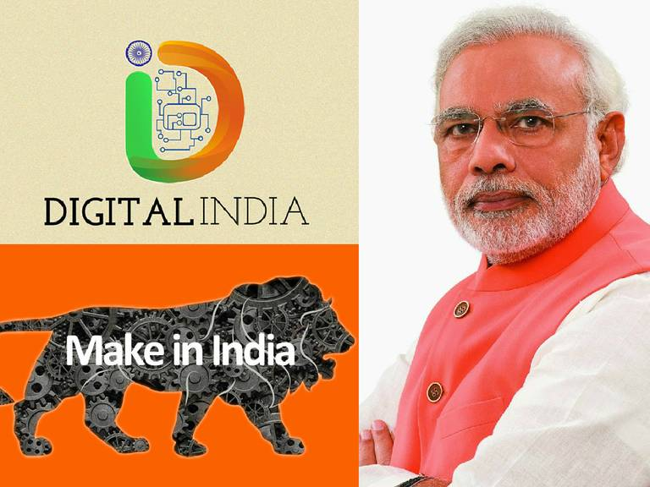
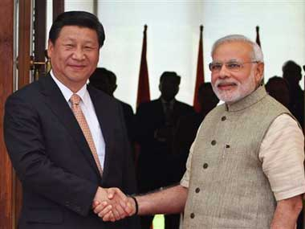
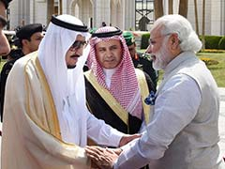
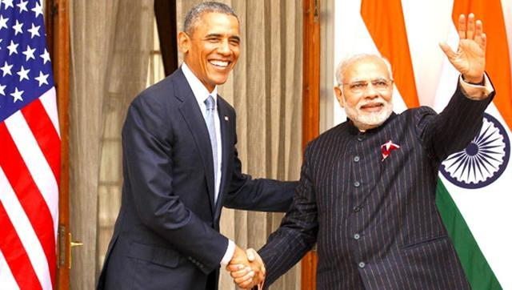
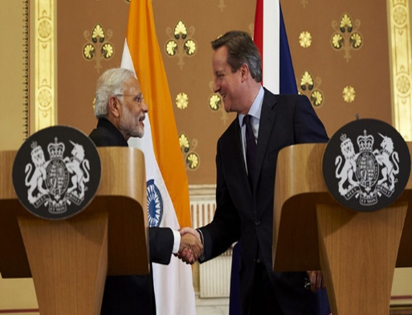
PM POLICIES –
INCREASING NEED TO HIRE ENGINEERS
Joint Ventures with foreign countries

Slide 8
CM POLICIES –
STUDENT CREDIT CARD SHCEME

Slide 9
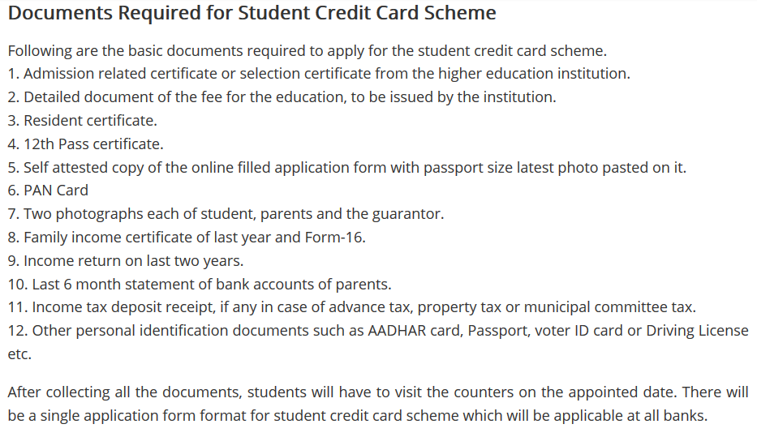

Slide 10
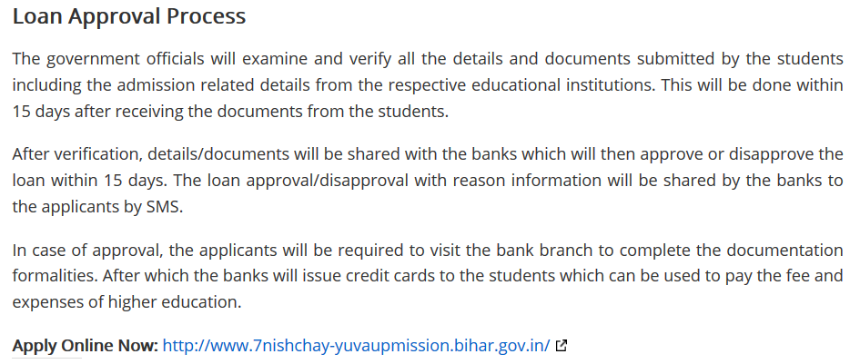

Slide 11
WHY CHOOSE BIT GROUP
EXCELLENT INFRASTURCTURE
20 ACRE CAMPUS
RAGGING FREE ENVIRONMENT
GOOD PLACEMENT RECORD
HIGHLY QUALIFIED FACULTY
WELL EQUIPED LABORATORIES
SKILL DEVELOPMENT
VARIOUS SPORTS FACILITIES & RESOURCES
EXTRA CO-CURRICULAR ACTIVITIES
ANNUAL FEST
NCC CENTER
TECHNOLOGY BUSINESS INCUBATOR (TBI)
PERSONALITY DEVELOPMENT PROGRAMS
REGULAR ONLINE EXAM CONDUCTION
SCHOLARSHIP
REWARDS LIKE LAPTOP, TABLETS FOR 1ST YEAR BASED ON MERIT IN ADMISSION TEST
FULLY WI-FI CAMPUS
BARRIER FREE CAMPUS
IN-HOUSE CANTEEN, DEPARTMENTAL STORE
HOSTELS, PARKING, 24 HOUR ELECTRICITY & WATER SUPPLY
OTHERS

Slide 12
SOME COLLEGE ACTIVITIES
Tech Guru Classes from Renowned Industrialists
Guest lectures from IITs & NITs Faculty
Workshops by Reputed Companies
Industrial Visits
Project Competition
Skill Development
College Fest
NCC Activities etc.

Slide 13
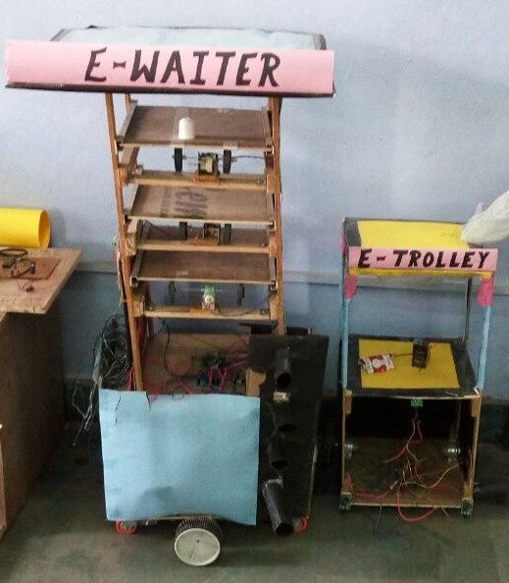
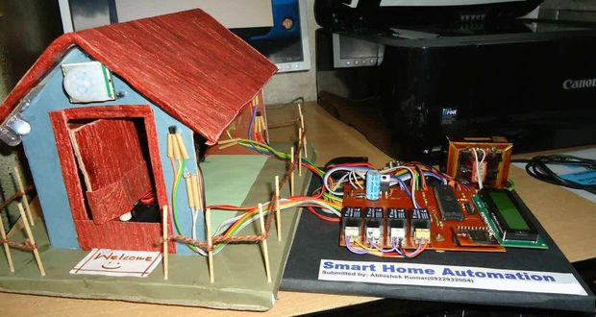
ENTREPRENEURSHIP DEVELOPMENT IN STUDENTS
Projects made by students:
Mini-Restaurant (includes a Robotic Waiter)
LED Cube
Automatic Solar Street Light
Home Automation using Arduino
College promote students to become entrepreneur and facilitate them to apply for funds in MSME, Start Up - Stand Up India, and National Policy for Skill Development and Entrepreneurship.

Slide 14
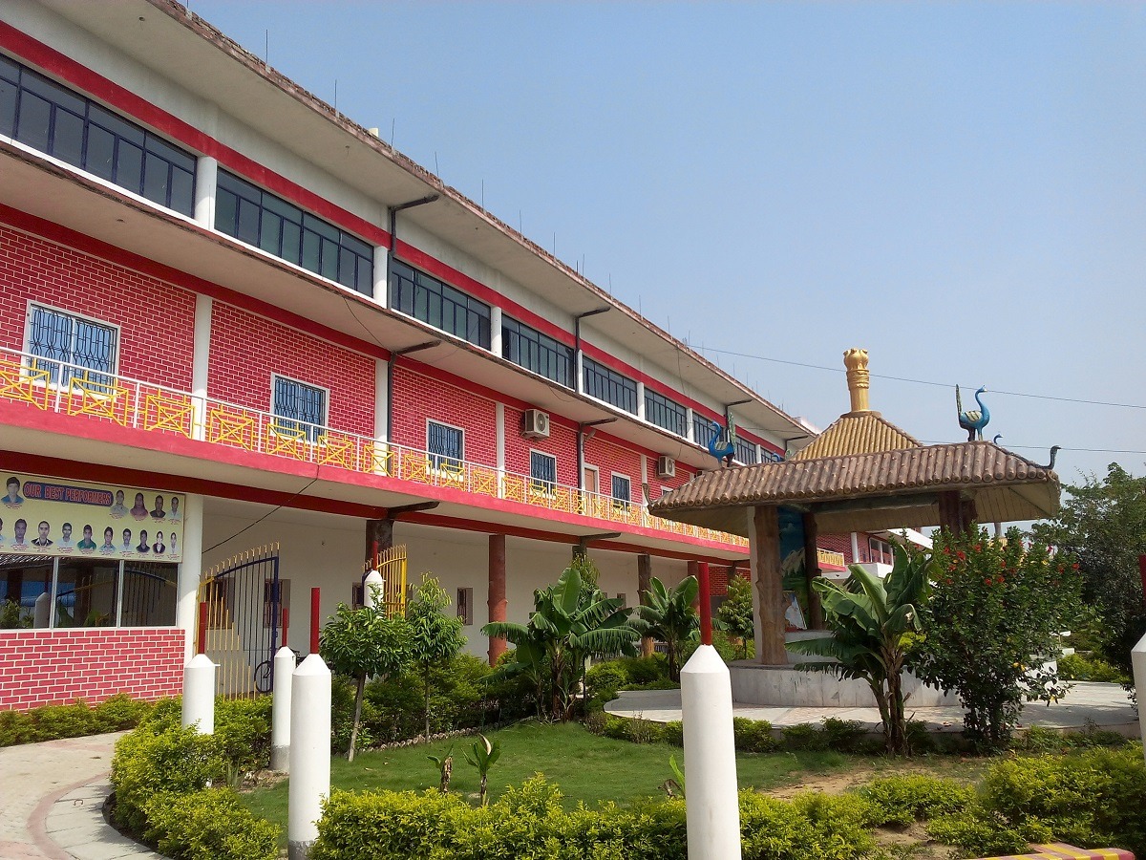
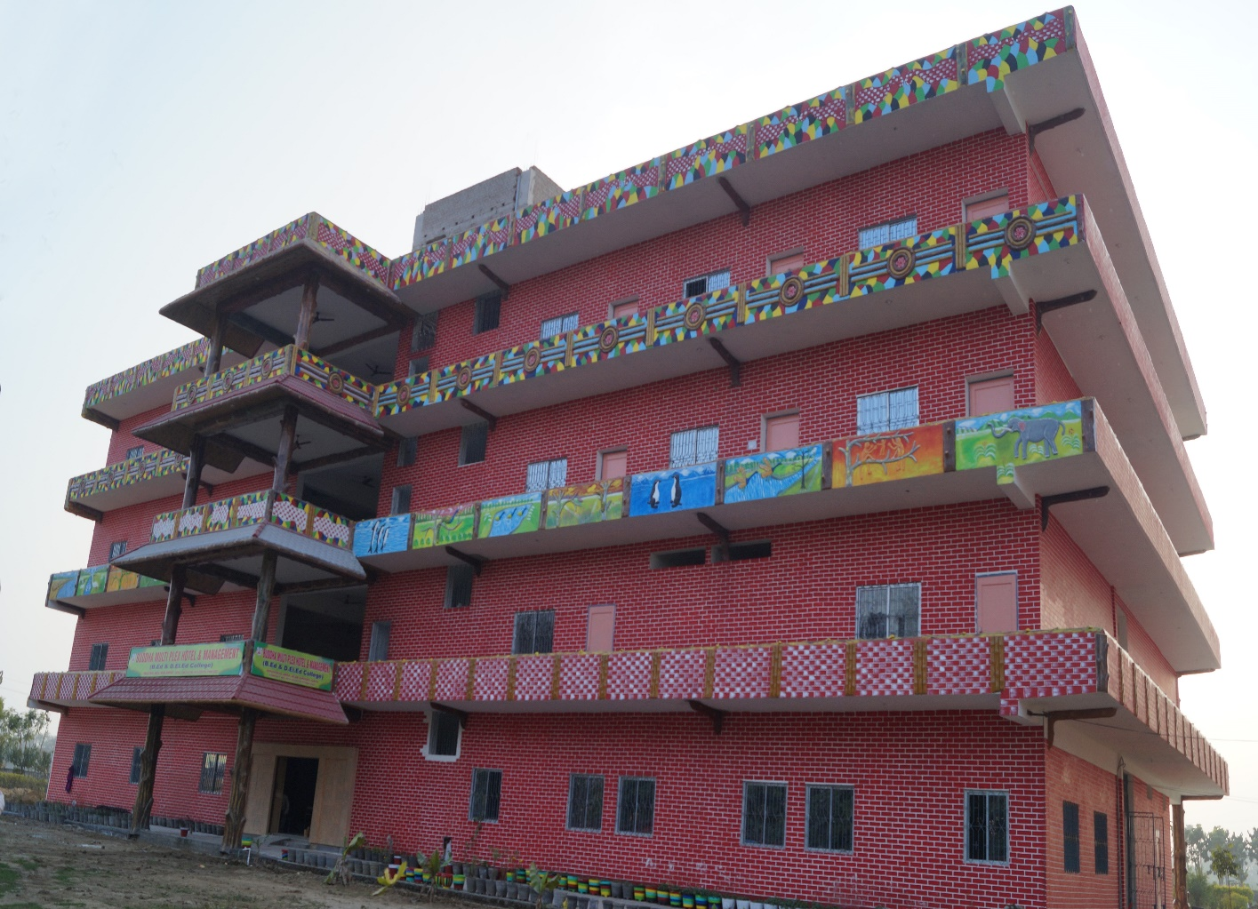
SOME COLLEGE RESOURCES HIGHLIGHTS
INFRASTUCTURE

Slide 15
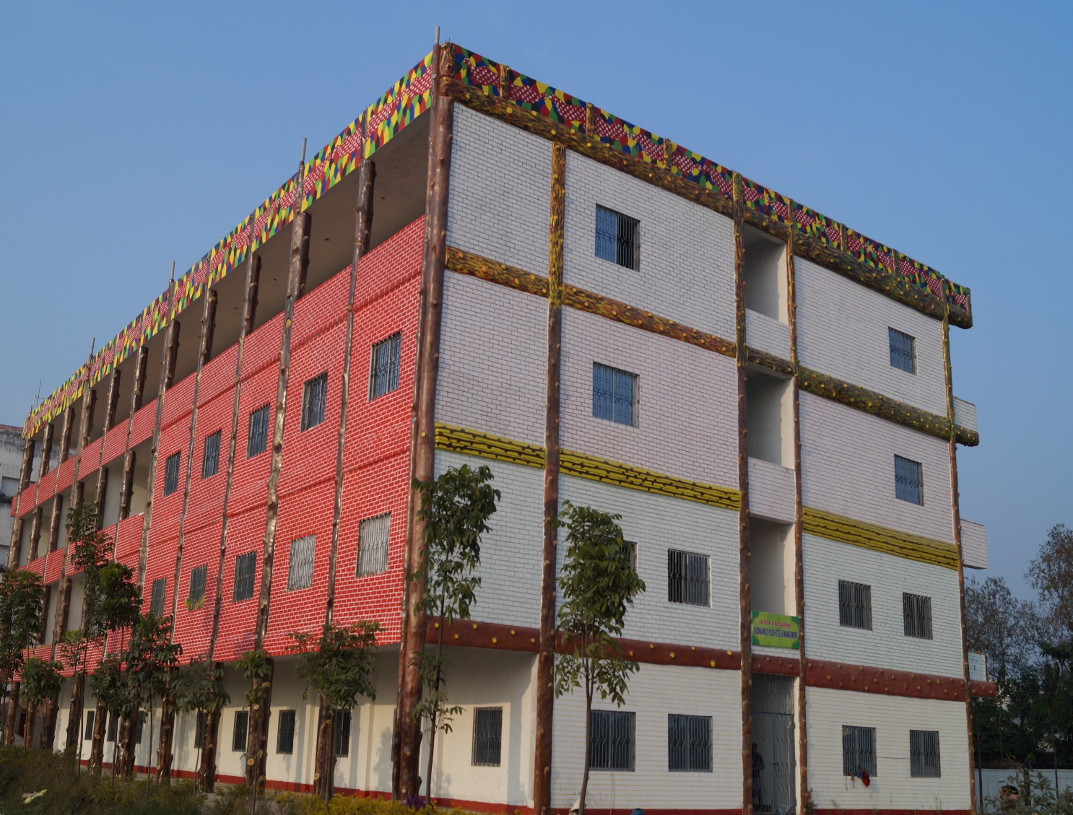
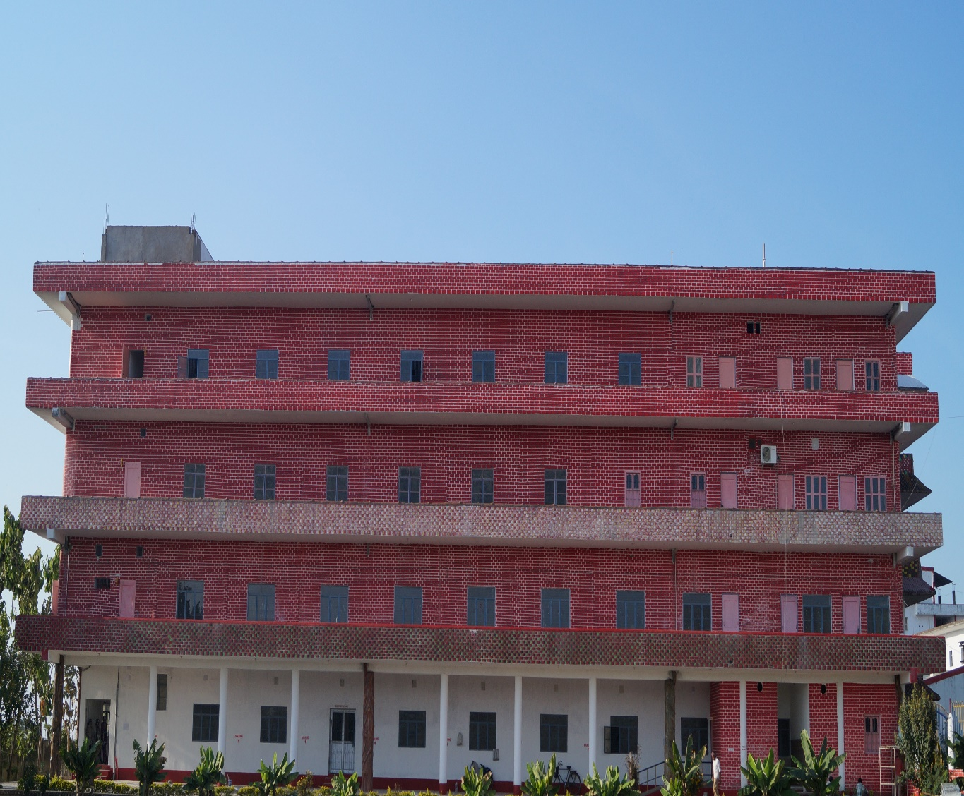

Slide 16
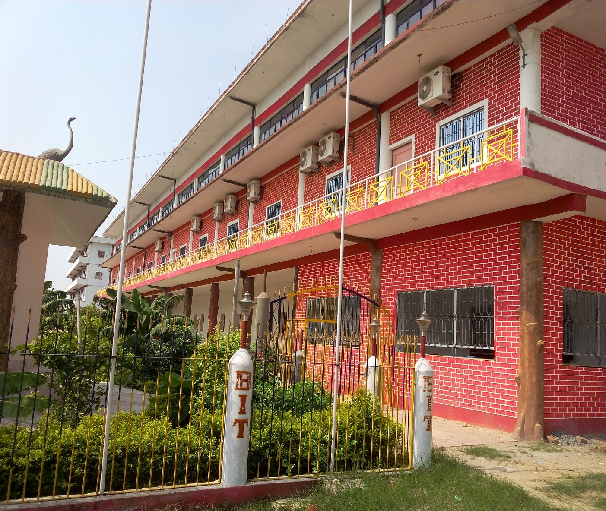
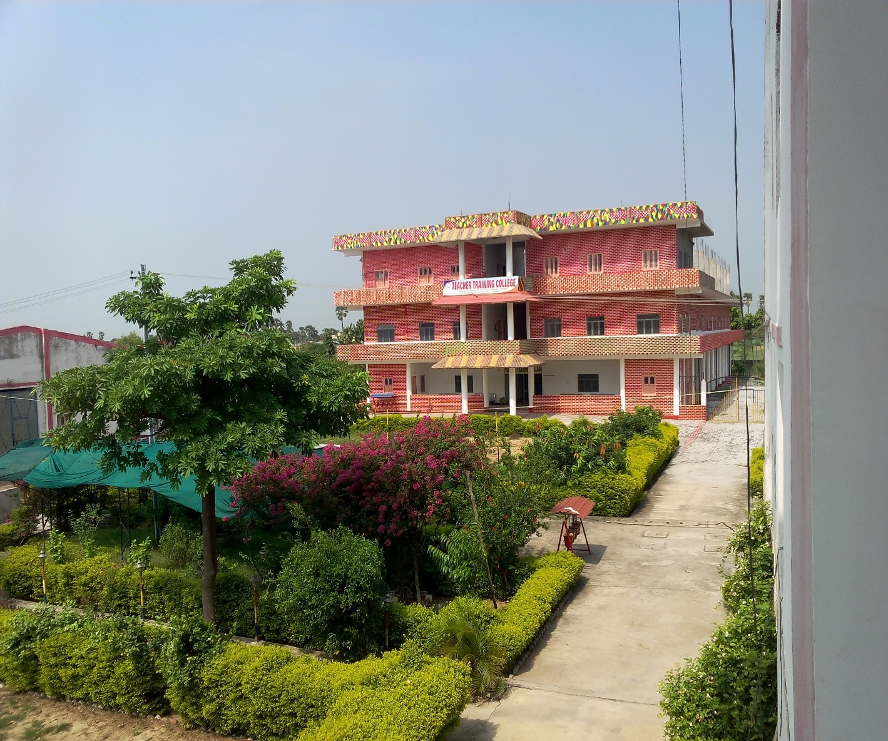

Slide 17
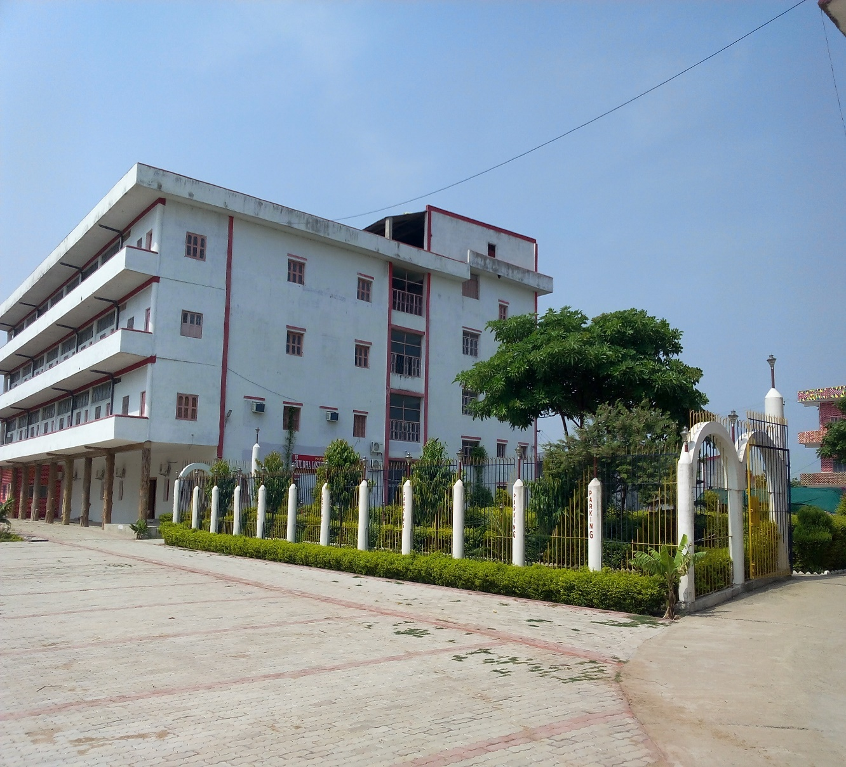

Slide 18
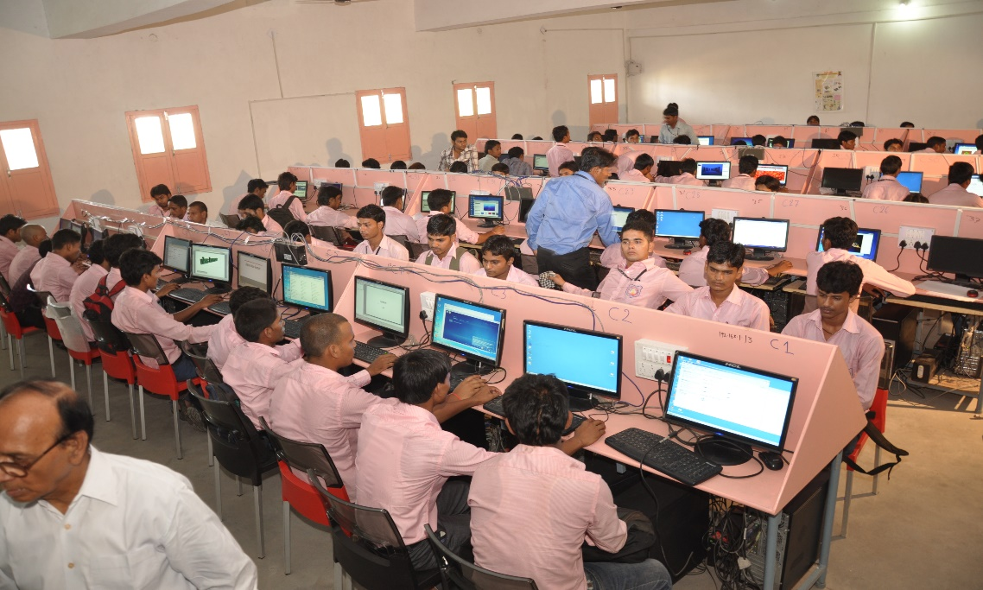
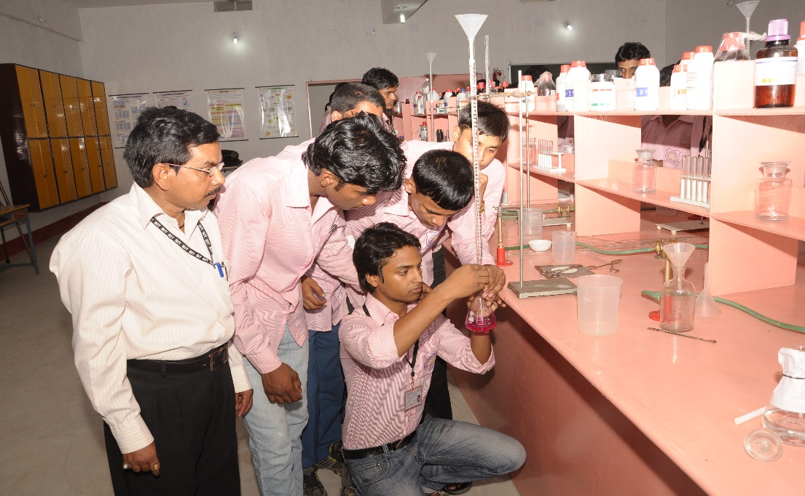
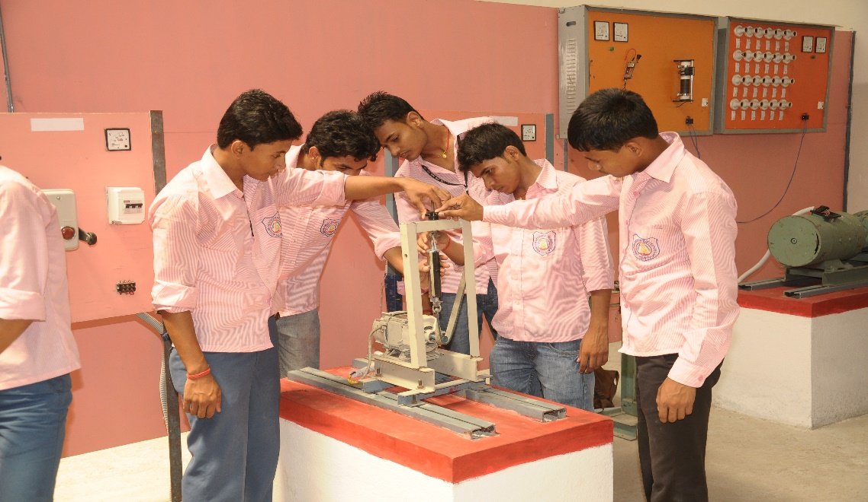
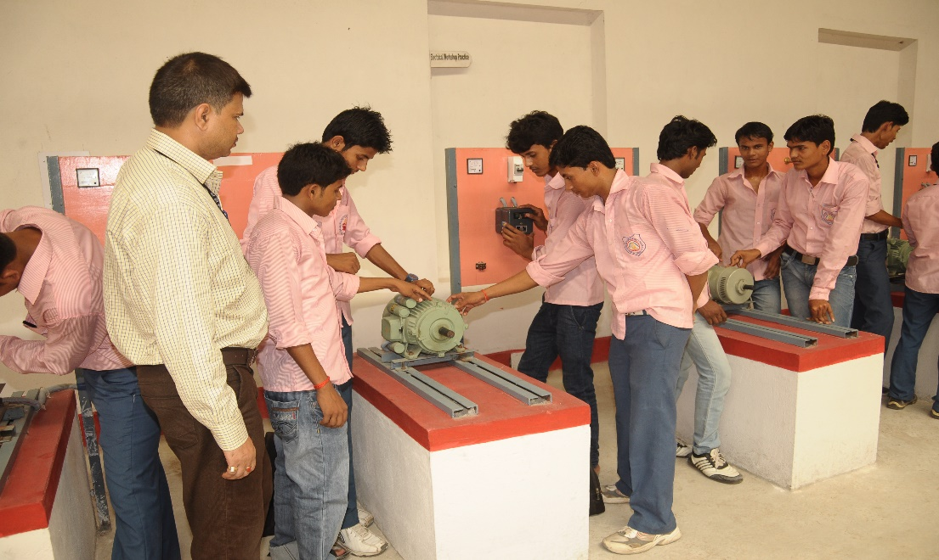
SOME LABORATORY INSIGHTS

Slide 19
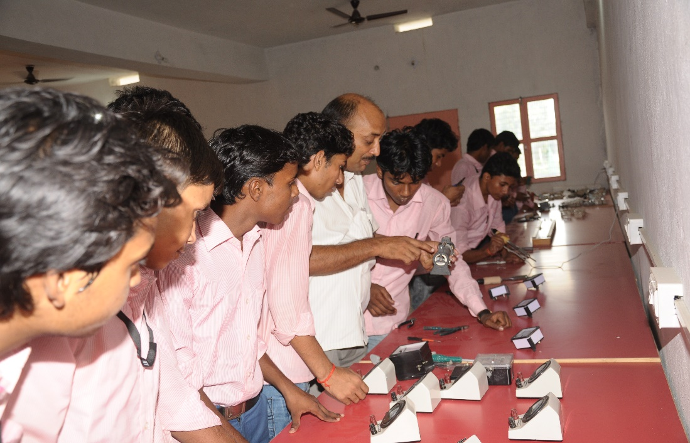
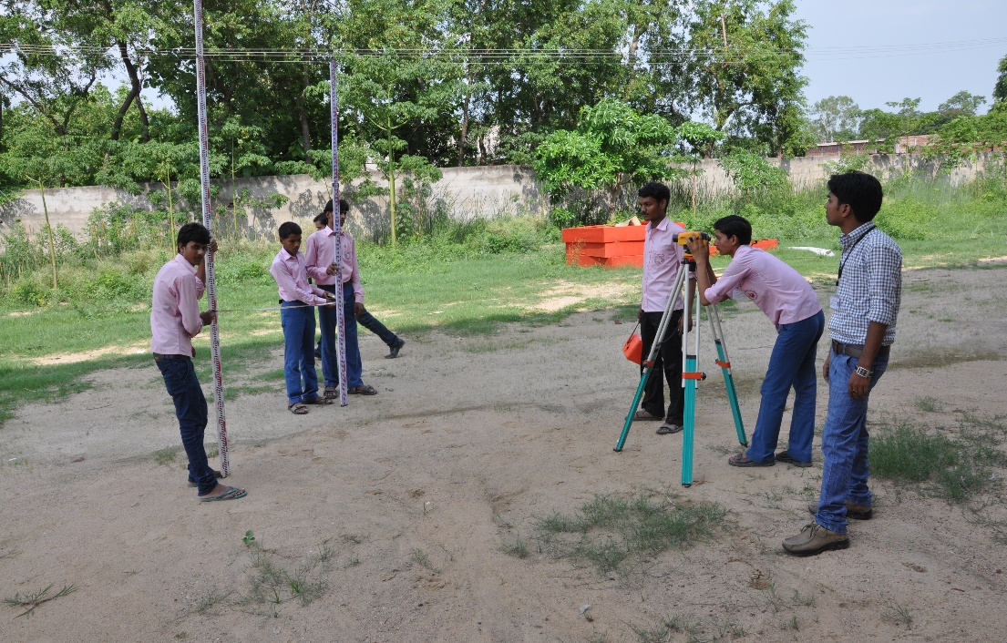
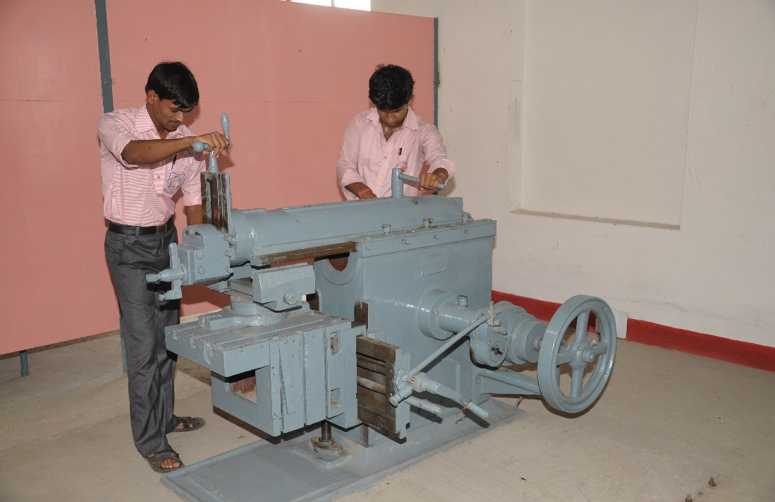
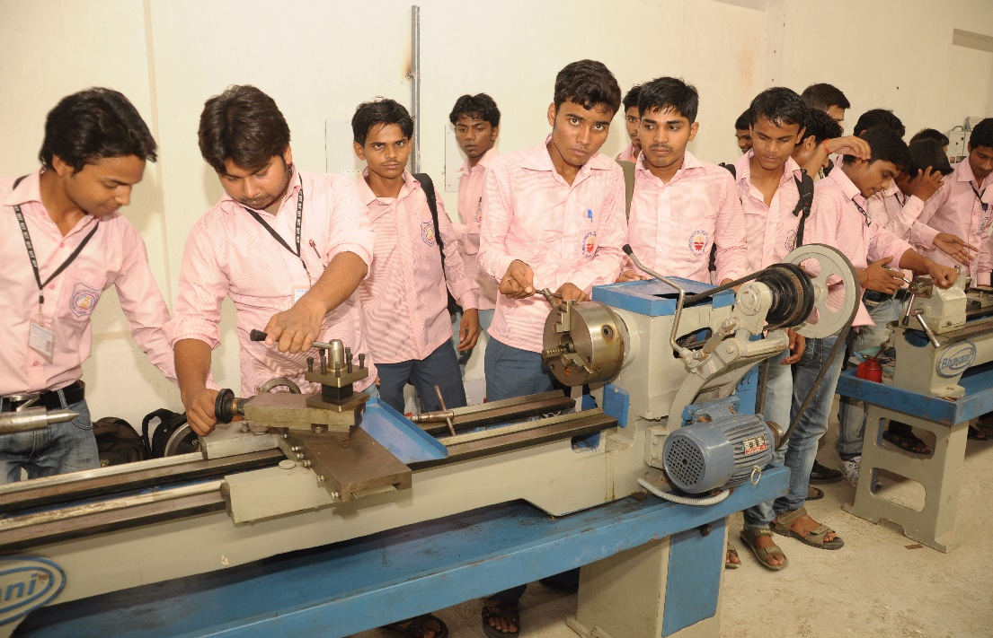

Slide 20
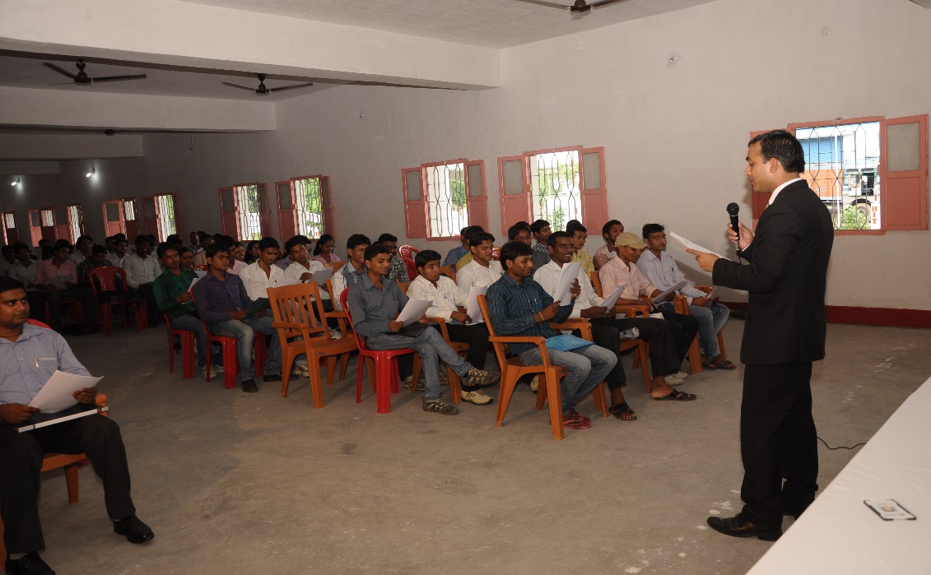
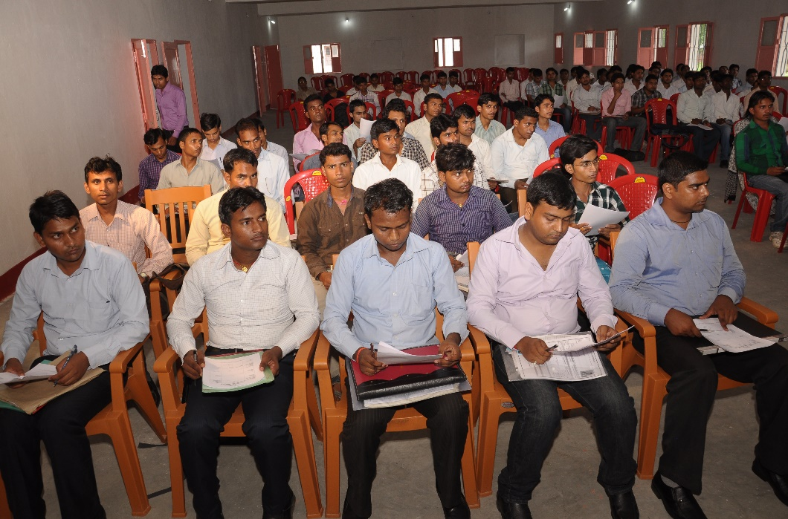
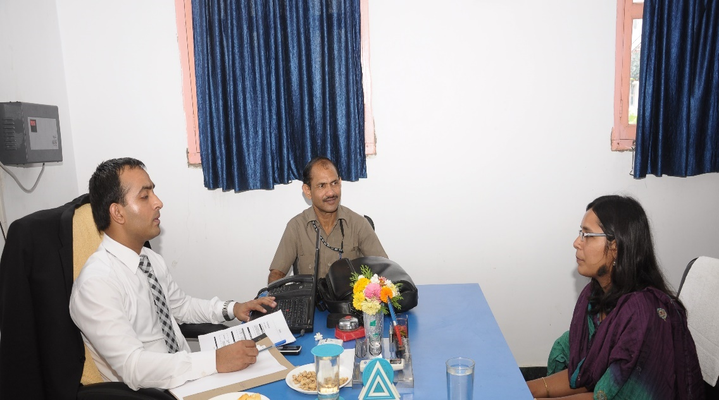
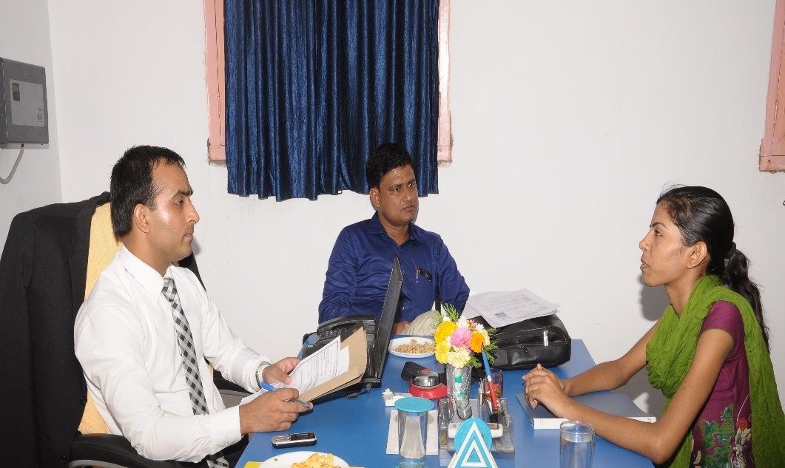
CAMPUS PLACEMENT

Slide 21
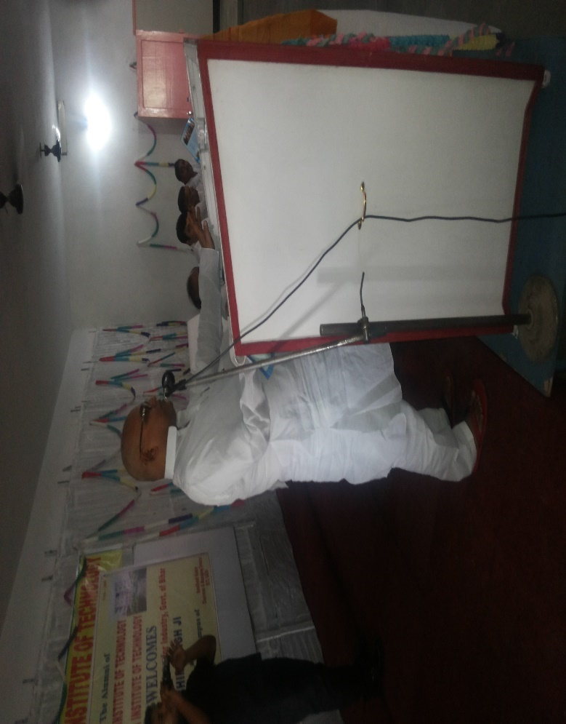
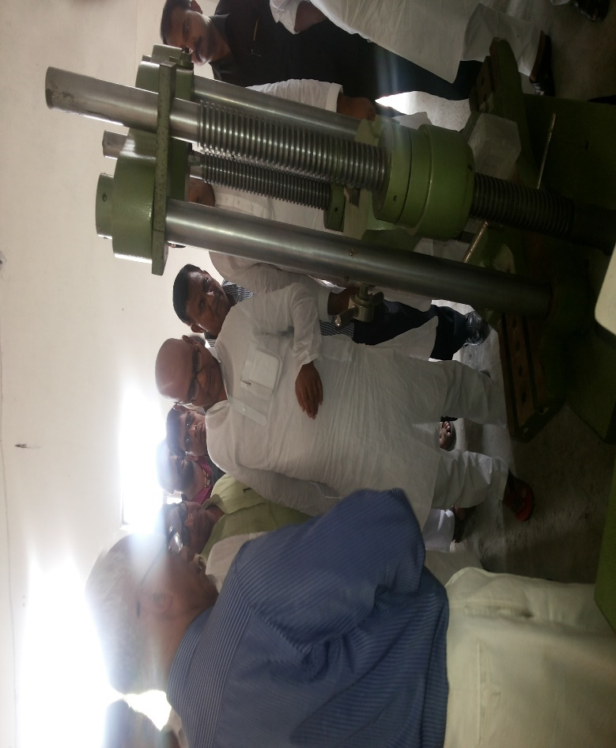
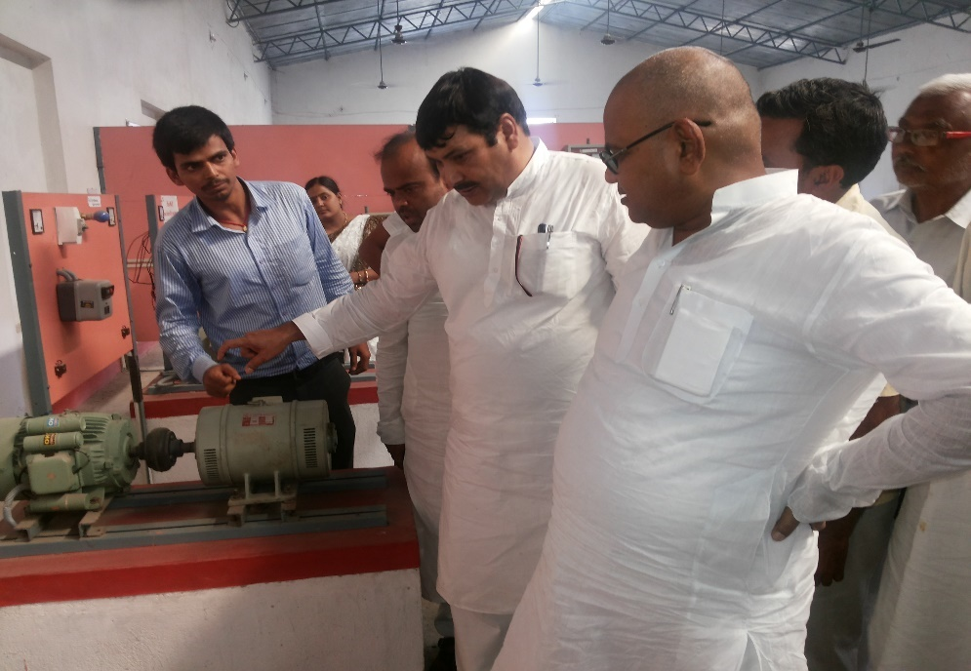
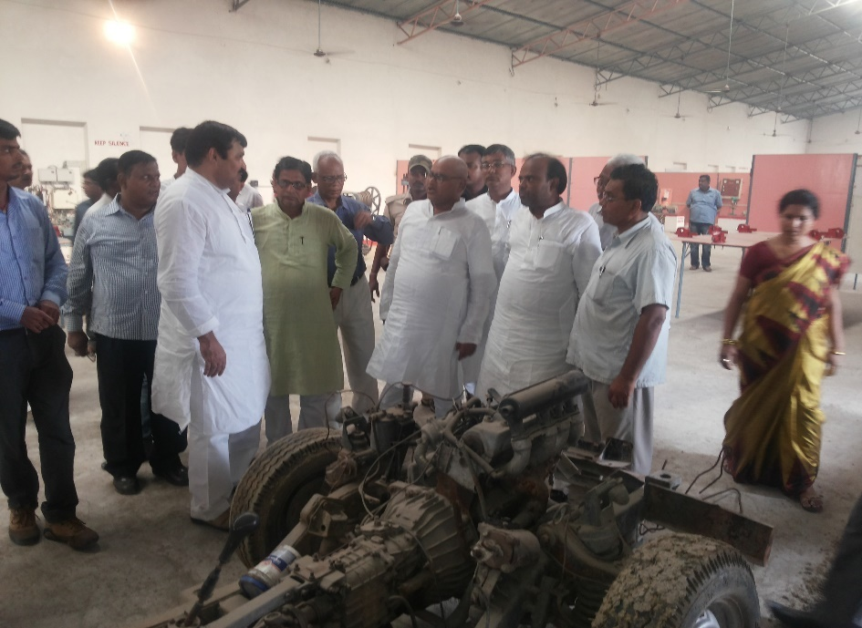
INDUSTRY CONNECT

Slide 22
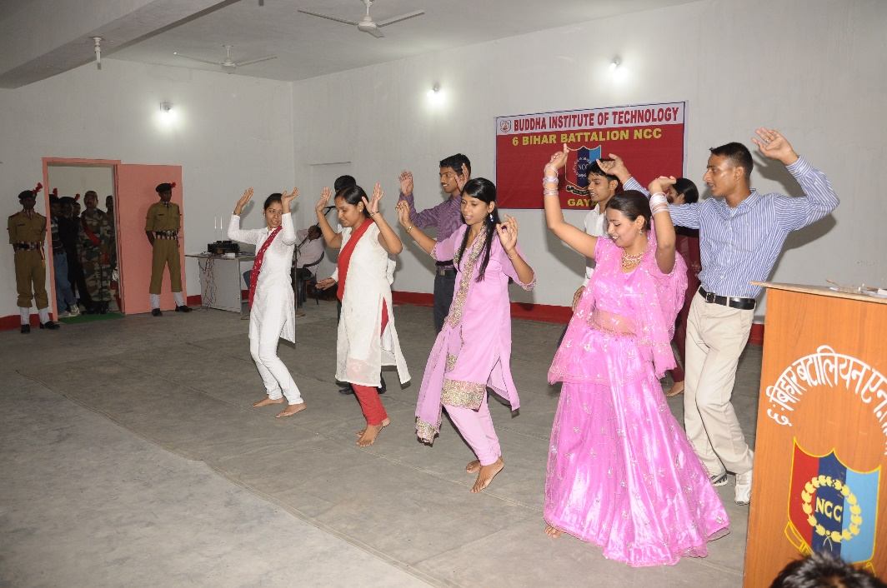
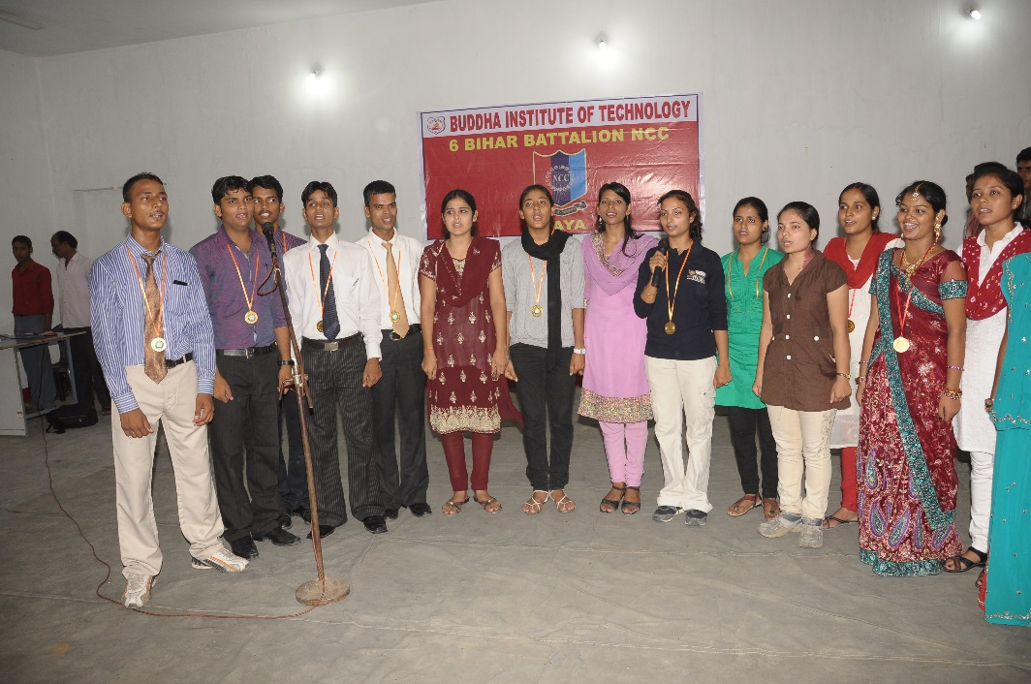
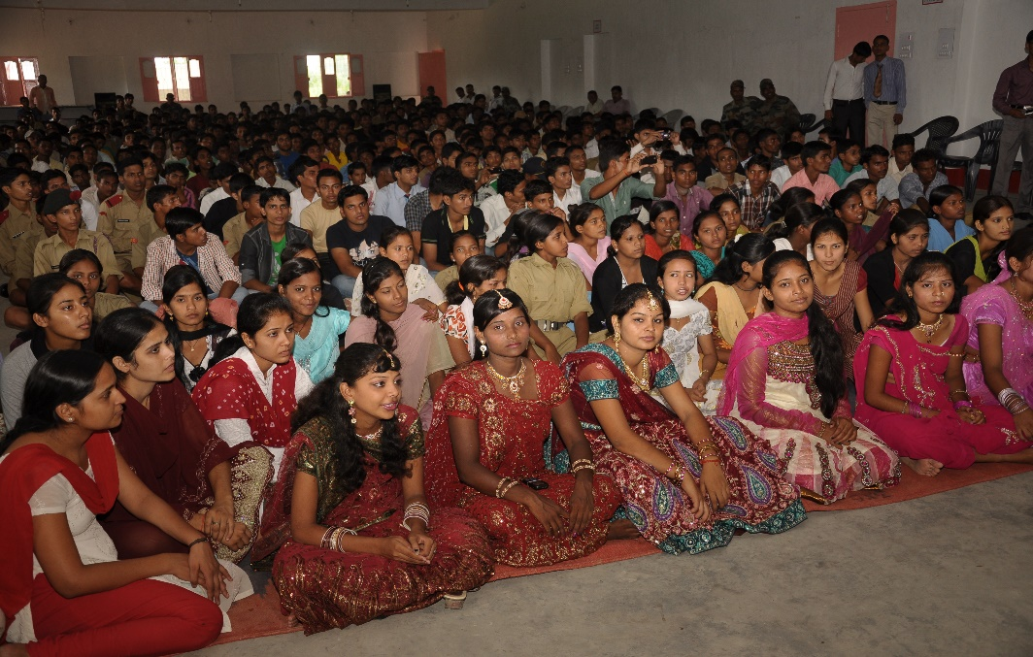
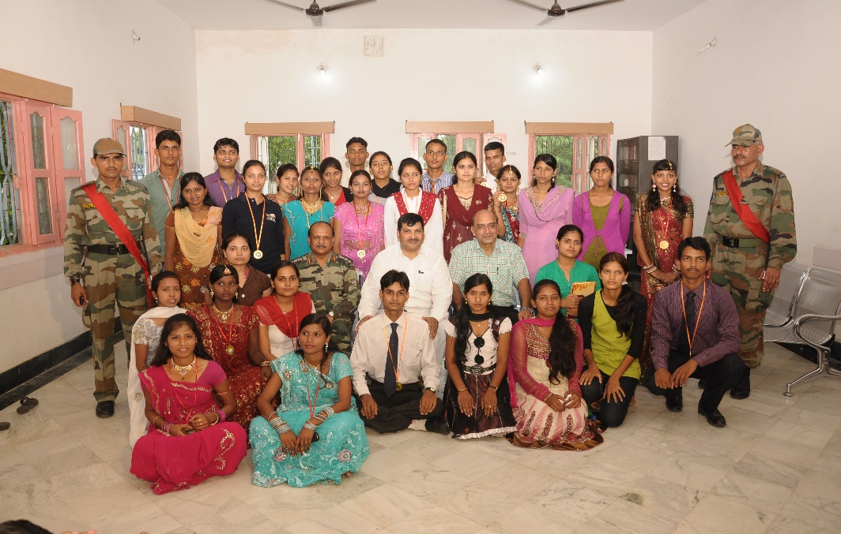
CULTURAL ACTIVITIES

Slide 23
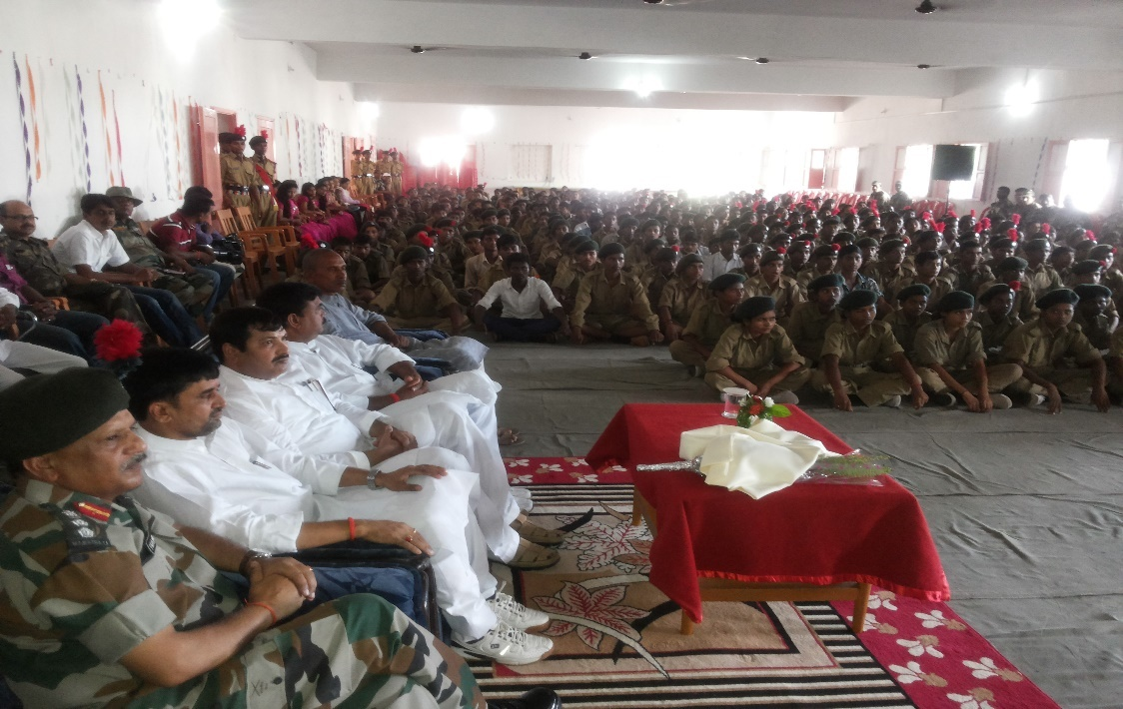
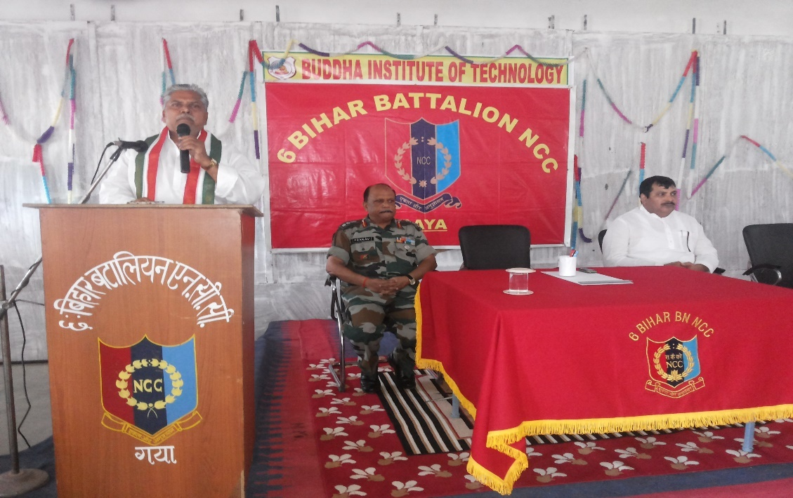
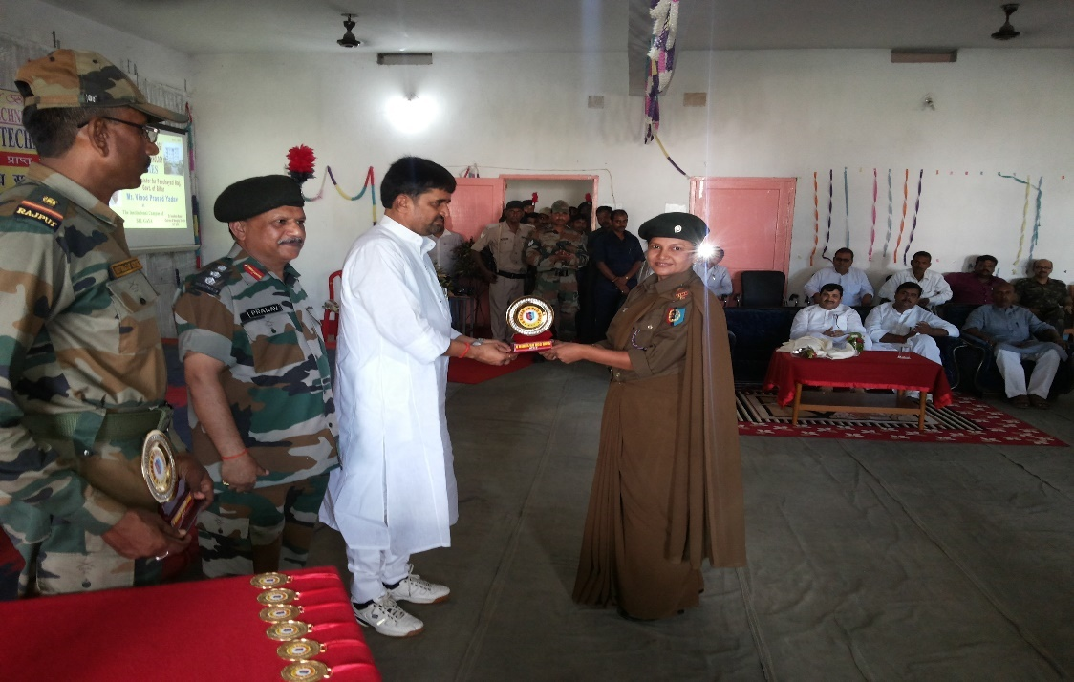
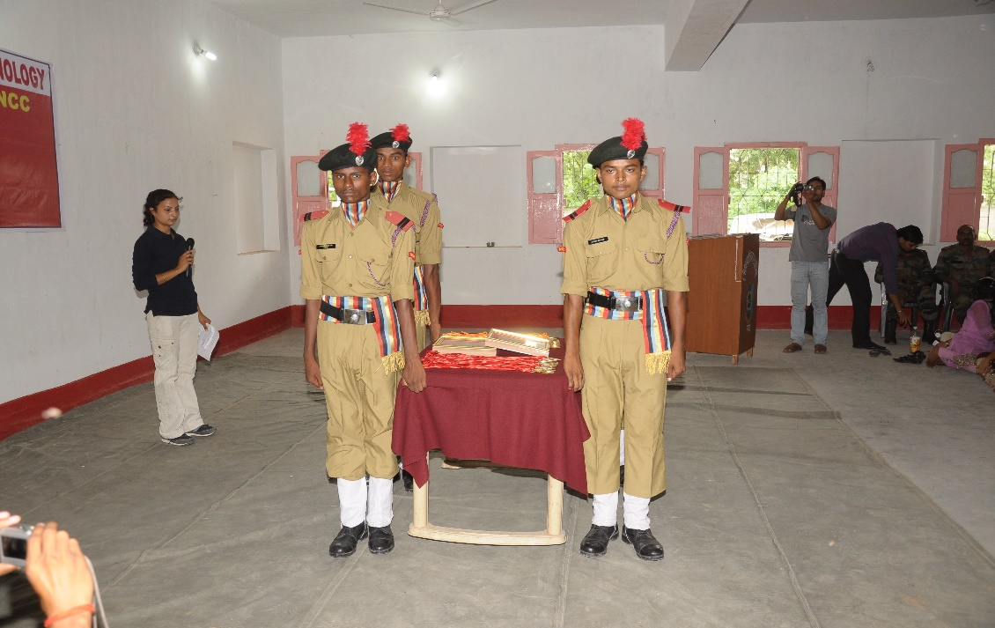
NCC ACTIVITIES

Slide 24
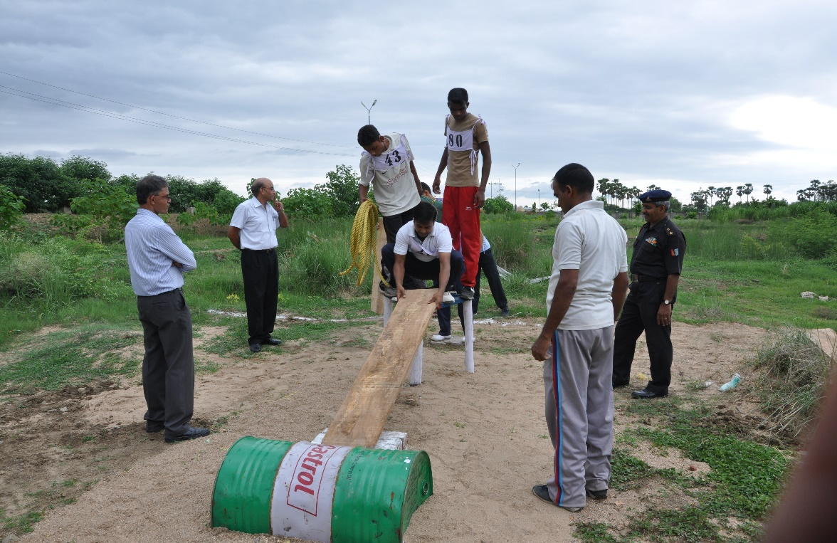
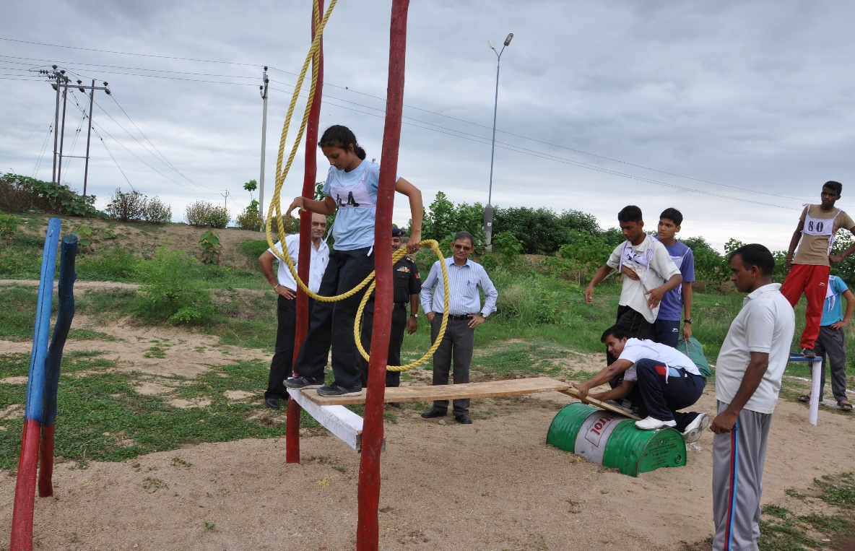
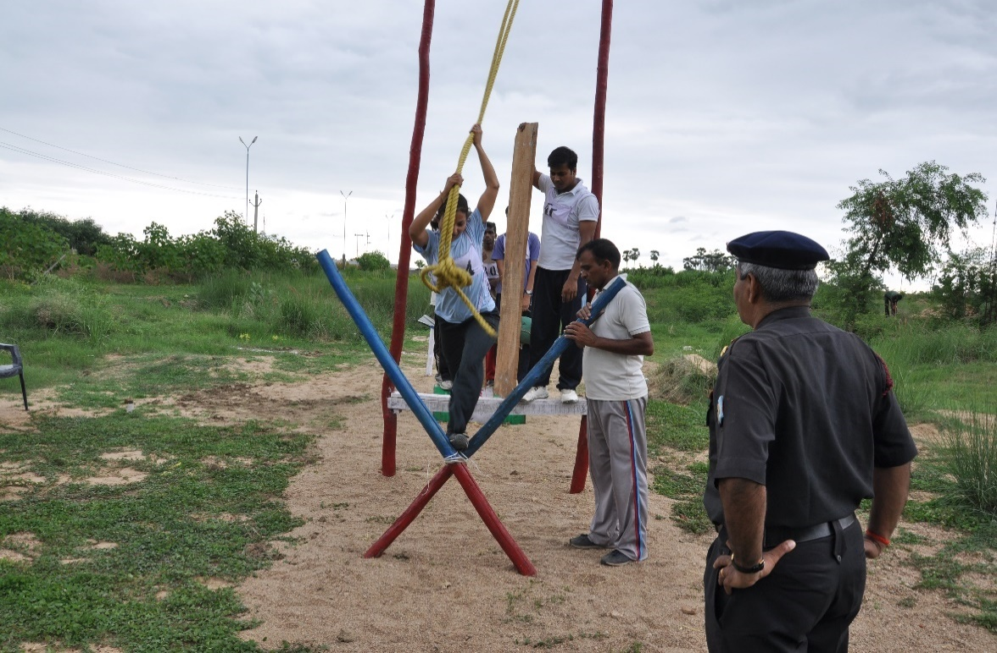
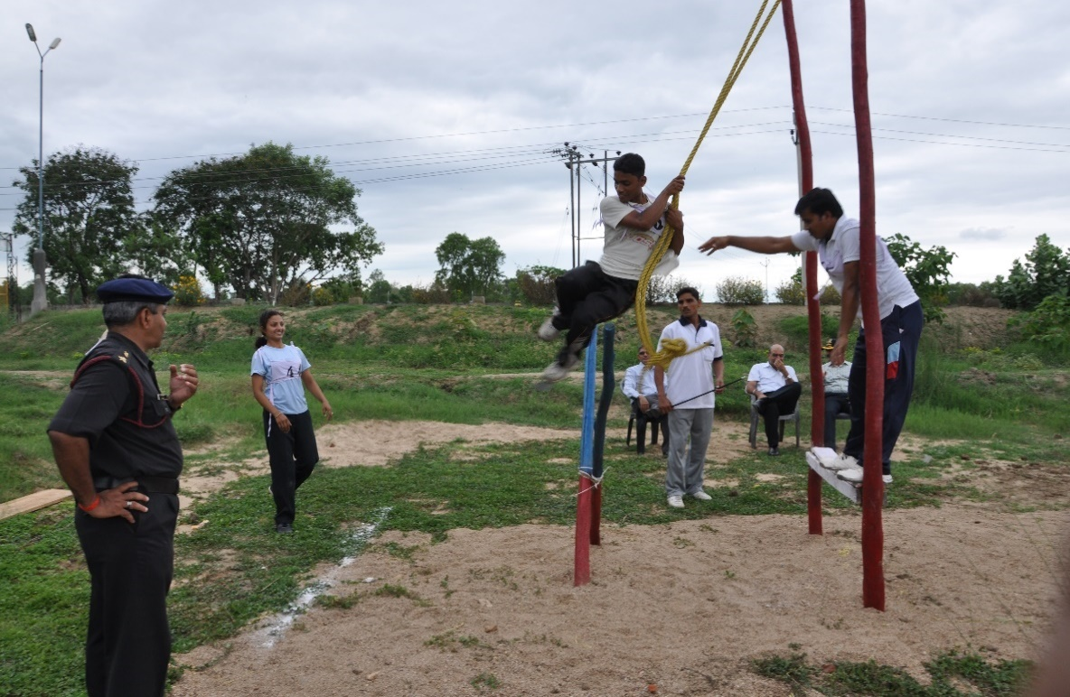

Slide 25
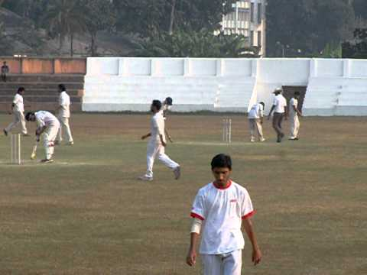
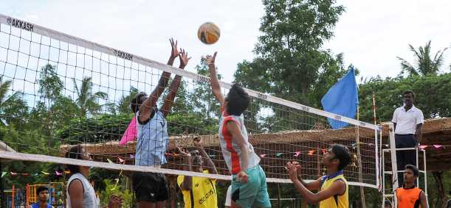
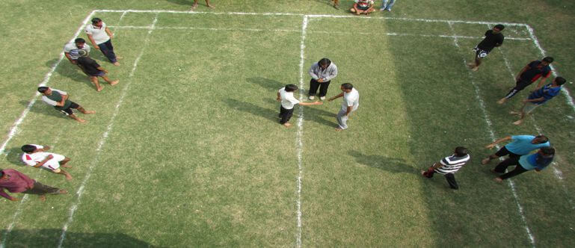
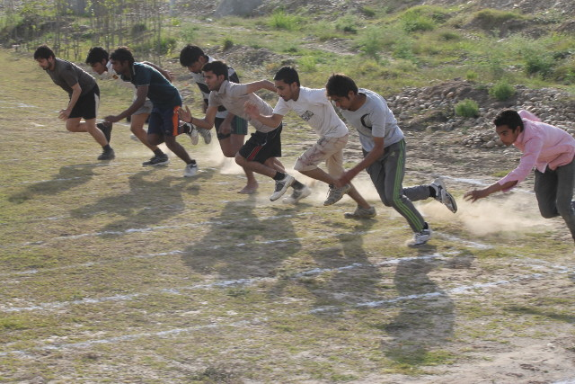
SPORTS FACILITIES

Slide 26
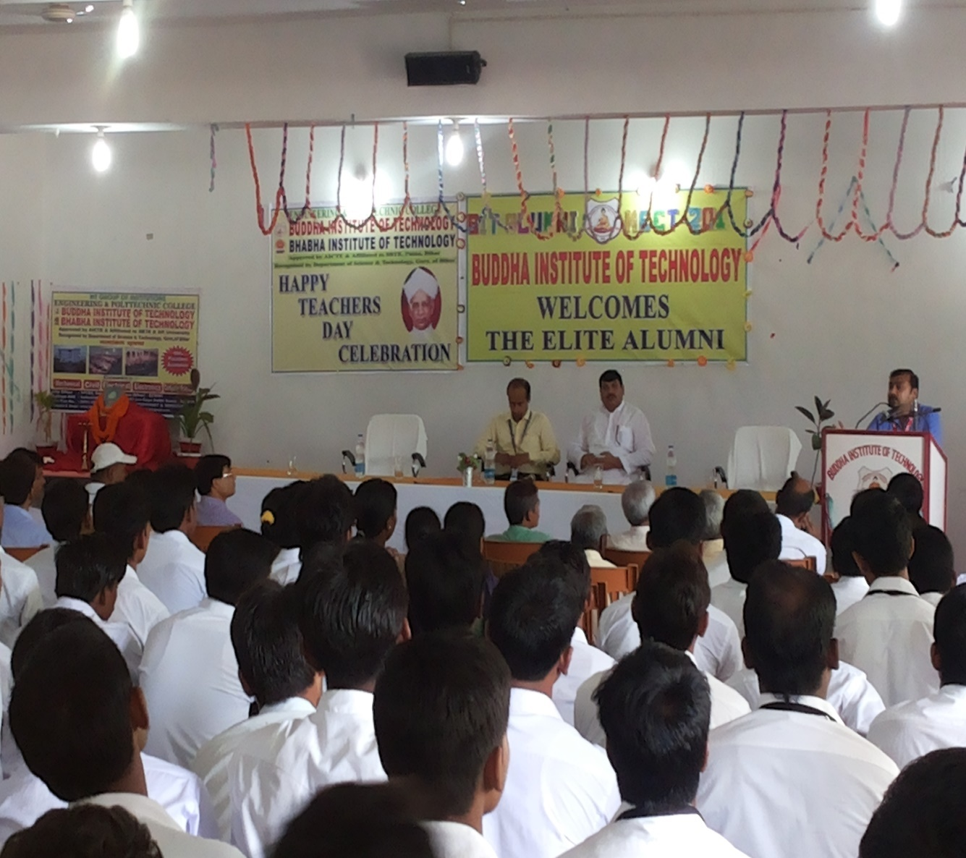
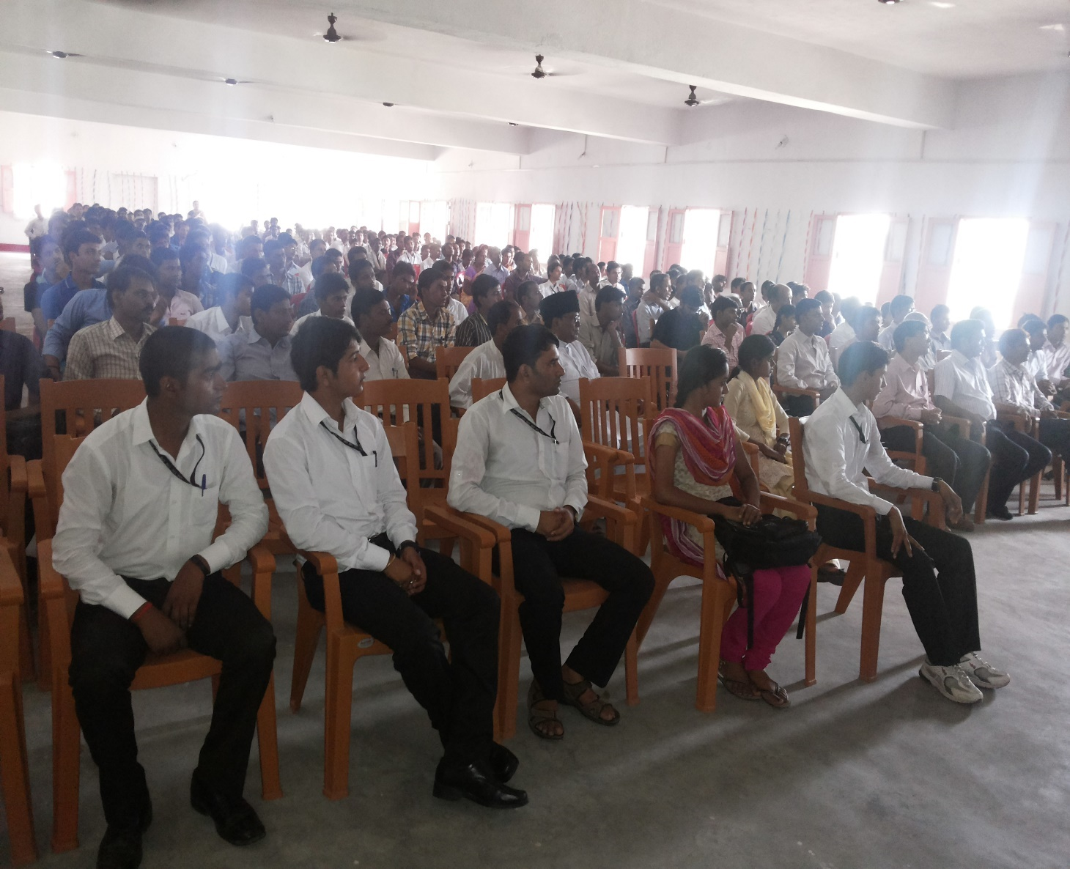
ALUMNI MEET & TEACHER’S DAY CELEBRATION

Slide 27




INDEPENDENCE DAY CELEBRATION

Slide 28
THANKS
BEST WISHES FOR FUTURE

